Slide 1
Cowichan Watershed Board Meeting – Review of conditions at lake Cowichan
July 30, 2018,
Presentation by Graham Kissack

Slide 2
Aerial view of Lake Cowichan Weir

Slide 3
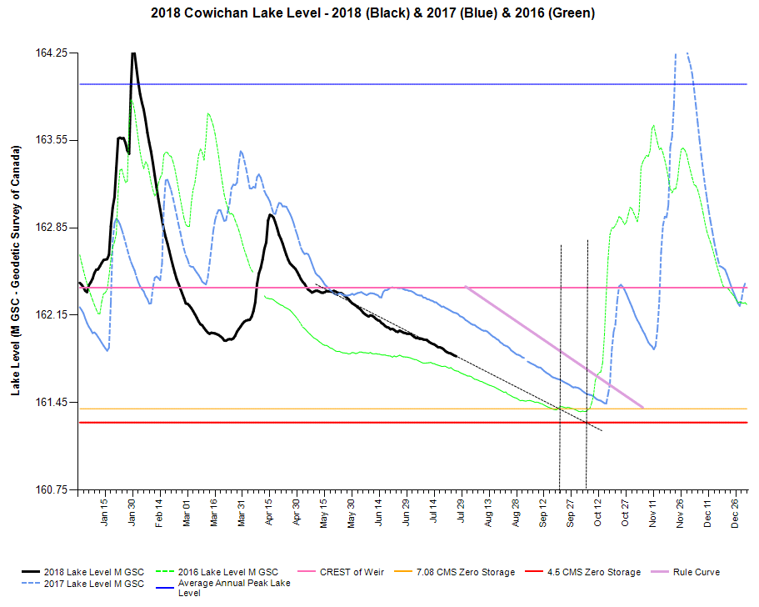
Projection shows inadequate inventory

Slide 4
Release of water from lake

Slide 5
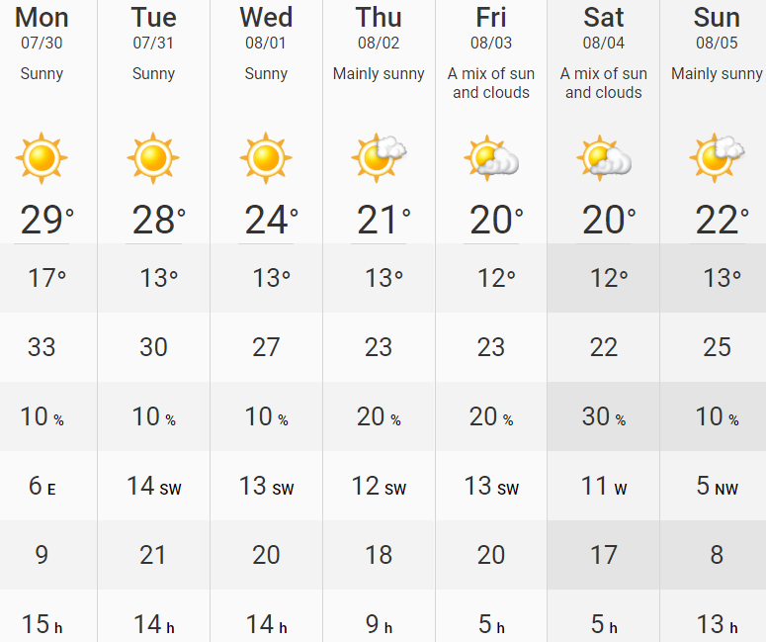
Weather Forecast for coming week shows hot dry weather. Rainfall not expected to return until mid to late October

Slide 6
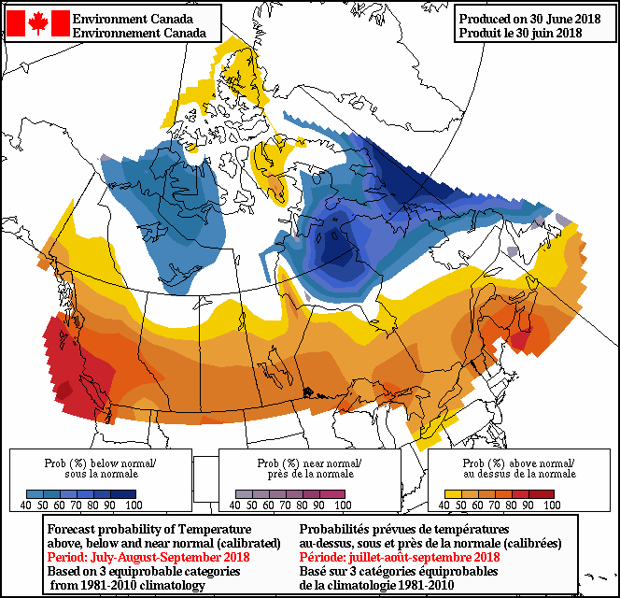
July / August /September Forecast

Slide 7
KWL projections (@ 10%ile summer) Pumping estimated to begin on Sep 12 @ 5.5 cms OR Sep 19 @4.5 cms

Slide 8
KWL projections (@ 2017 summer) Pumping estimated to begin on Oct 4 @5.5 cms OR Oct 25 @4.5 cms

Slide 9
Actions moving forward
Consider further flow adjustments – 5.5 cms down to 4.5 cms beginning as early as Aug 1
Catalyst to prepare for potential pumping of water using negative storage. Unproven solution:
Not yet approved by FLNRO or DFO
Impact on Vancouver Island Lamprey?
Impact on waterfront properties?
Catalyst to apply for authorization to steward the fish and fish habitat of Lake Cowichan shoreline with specific focus on the SARA listed Vancouver Lamprey
Province to conclude the 10 year license for pumping water from lake to river to ensure this action is available if needed

